Slide 1




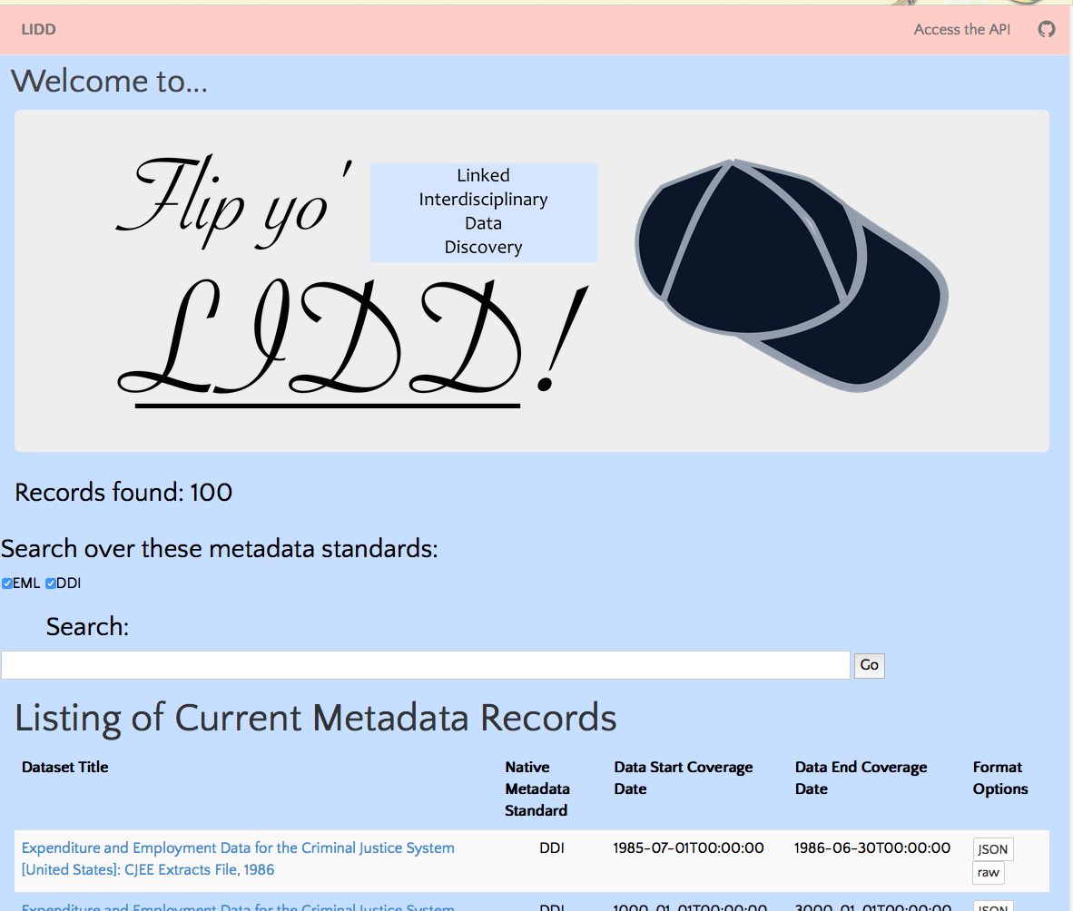


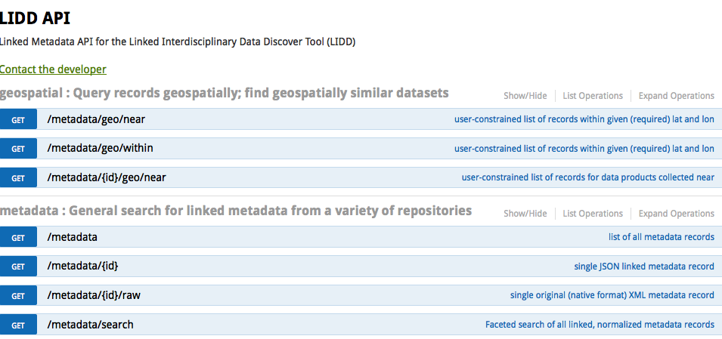

Linked Interdisciplinary Data Discovery Matthew A. Turner, Mary Vardigan, David Dubin, Rebecca Koskela, Lucas Sheneman Northwest Knowledge Network, University of Idaho; ICPSR, University of Michigan; University of Illinois, Urbana-Champaign; DataONE, University of New Mexico, USA
How can linked data enable personalized
data discovery across diverse repositories:
What are the right tools to enable
real, reproducible, interdisciplinary
research across repositories?
https://mt.northwestknowledge.net/lidd
User-centric Web App
Users not expected to know about metadata or linked data
Easy log in and access to researcher’s scholarly record for personalized experience; via ORCiD OAuth2 server and user data API.
Linked Metadata API
/api/metadata[/{id}[/raw]]
/api/metadata/search
/api/metadata/(near, within)
future: multiple formats, SPARQL, text analysis
Public
API
https://mt.northwestknowledge.net/lidd/api
Linked Normalized Metadata Model
References:
JSON for Linking Data, http://json-ld.org
Matt Jones, Ecological Metadata Language Specification, https://knb.ecoinformatics.org/#external//emlparser/docs/eml-2.1.1
Dave Vieglais, d1_local_cache, https://github.com/vdave/d1_local_cache
ICPSR Bulk Metadata Cache, http://www.icpsr.umich.edu/icpsrweb/content/membership/or/metadata/xml/index.html
Normalized Metadata (JSON-LD, HCLS)
DataONE Parser
D1 EML
D1 D.Core
ICPSR Parser
ICPSR DDI
D1 FGDC
Other Repositories...
formats
other
repos’
Acknowledgements:

